Slide 1
House Price Prediction Using ML

Slide 2
Agenda -
Aim and Objective
Domain Explanation
Literature Survey
Problem Statement
Existing System
Proposed System
Result and Discussion
Result Screenshot
Conclusion and Future SWPE
References

Slide 3
Aim and Objective
The aim is to predict the efficient house pricing for real estate customers with respect to their budgets and priorities. By analyzing previous market trends and price ranges, and also upcoming developments future prices will be predicted.

Slide 4
Domain Explanation -
Our project is a machine learning app, based on certain specifications of your future home it will try to guess the most accurate price.
Information such as state, city, area, stores.
Technology Used :
1. Machine Learning →
In general, any machine learning problem can be assigned to one of two broad classifications:
Supervised learning
Unsupervised learning.

Slide 5
Supervised Learning: In supervised learning, we are given a data set and already know what our correct output should look like, having the idea that there is a relationship between the input and the output. Supervised learning problems are categorized into "regression" and "classification problems.
In a regression problem, we are trying to predict results within a continuous output, meaning that we are trying to map input variables to some continuous function.
In a classification problem, we are instead trying to predict results in a discrete output. In other words, we are trying to map input variables into discrete categories.

Slide 6
• Unsupervised Learning : Unsupervised learning allows us to approach problems with little or no idea what our results should look like. We can derive structure from data where we don't necessarily know the effect of the variables. We can derive this structure by clustering the data based on relationships among the variables in the data. With unsupervised learning there is no feedback based on the prediction results.

Slide 7
Literature Survey -
To extrapolate tweaks in mortgage lending, receivables, and housing affordability in specific geographic locations, housing economists are used. HPI is ineffective in predicting the price of a given property because it is a reference number based on all transactions. Instead of only duplicate purchases from earlier decades, many factors such as district, age, and the number of floors must be addressed. Machine learning has become a critical prediction approach in recent seasons, thanks to the significant rise toward Big Data, because it can estimate property values more correctly based on their qualities, regardless of prior year's data. Numerous publications investigated this issue and shown the capabilities of the machine learning approach, but the vast number of them compare the effectiveness of the models without taking into account the combination of several machine learning models.
Notes:
© Star Health and Allied Insurance Co. Ltd.2010 - 11
‹#›

Slide 8
S. Lu et al. carried out an experiment on home price forecasting using a hybrid regression approach, although finding the best answer involves extensive parameter adjustment. The Stacked Function approximation strategy a machine learning ensemble technique, was used to maximize the projected ability to make appropriate to the relevance of model combination. Q. Qiu retrieved and uploaded the "Housing Price in Beijing” dataset to Kaggle. We were able to examine the reliability of each.Asset prices are affected by a number of things. Categories these elements into 3 number of categories for this process: investigation, thinking, and territory. States of being are conductivity characterized by a house that can be seen by humans, such as the value of the house, the number of bedrooms, the easy accessibility of kitchen and parking space, the approachability of the yard nursery, the zone of land and configurations, and the age of the house, whereas an assumed is an idea rendered by design professionals to incentivize prospective customers, such as the likelihood of a moderate home, strong and green environment, and high - end restrictions.

Slide 9
Problem Statement -
Housing prices are an important reflection of the economy, and housing price ranges are of great interest for both buyers and sellers . Ask a home buyer to describe their dream house, and they probably won’t begin with the height of the basement ceiling or the proximity to an east-west railroad. But this playground competition’s data-set proves that much more influences price negotiations than the number of bedrooms or a white-picket fence.

Slide 10
Existing System -
There are several approaches that can be used to determine the price of the house, one of them is the prediction analysis. The first approach is a quantitative prediction. A quantitative approach is an approach that utilizes time series data. The time-series approach is to look for the relationship between current prices and prevailing prices. The second approach is to use linear regression based on hedonic pricing. Previous research conducted by Gharehchopogh using linear regression approach get 0,929 errors with the actual price. In linear regression, determining coefficients generally using the least square method, but it takes a long time to get the best formula

Slide 11
Proposed System -
The land prices are predicted with a new set of parameters with a different technique. Also we predicted the compensation for the settlement of the property. Mathematical relationships help us to understand many aspects of everyday life. When such relationships are expressed with exact numbers, we gain additional clarity Regression is concerned with specifying the relationship between a single numeric dependent variable and one or more numeric independent variables. House prices increase every year, so there is a need for a system to predict house prices in the future. House price prediction can help the developer determine the selling price of a house and can help the customer to arrange the right time to purchase a house

Slide 12
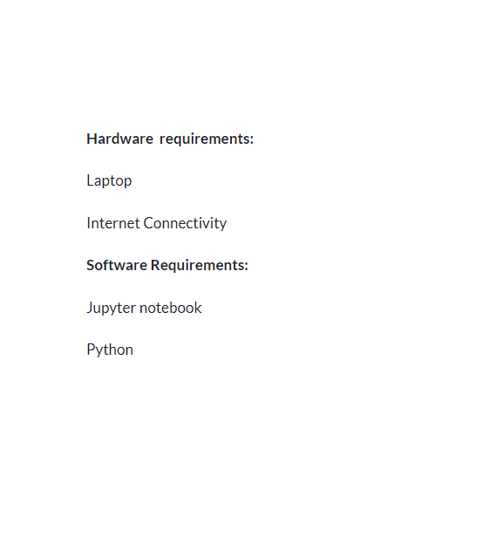
Hardware And Software Requirements

Slide 13
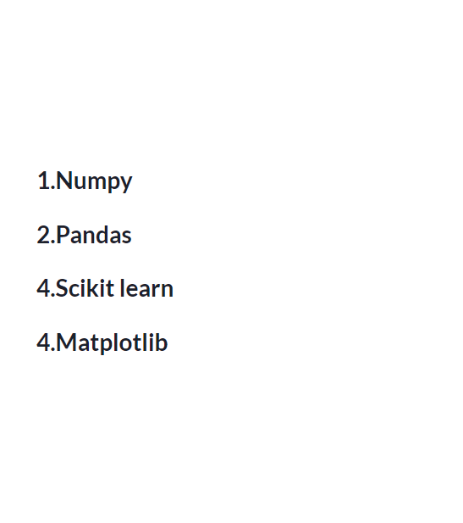
Modules

Slide 14
Result and Discussion
In machine learning, it is a general practice to rely on a correlation matrix to decide what features to be incorporated into our models. It presents the correlations between LRPi and each feature, and shows that housing floor area has the largest correlation with prices, followed by property age, travelling time to Central District and floor level. In comparison, correlations between each orientation and prices are very close to zero and so they are excluded from our estimation. Then, we present the data visualisation to portray the relationship between property prices and each selected feature. All the charts exhibit the expected relationship between the features and the housing prices.

Slide 15
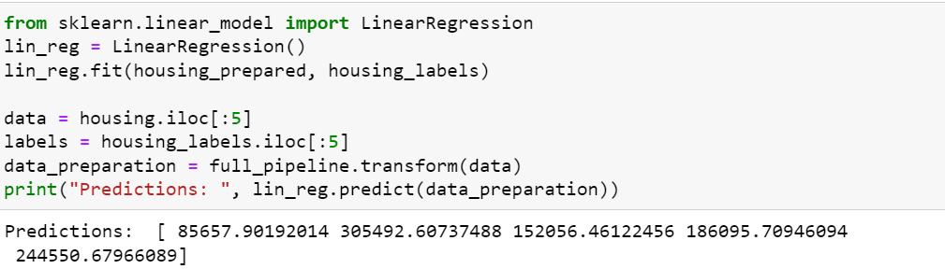
Result screenshot -

Slide 16
Conclusion and Future SWPE
We have used a data set of 20,641 houses with a number of parameters. We have used 50 percent of the data set to train the machine and 50 percent to test the machine. The results are truly accurate. And we have tested it with different parameters also. Not using PSO makes it easier to train machine with complex problems and hence regression is used

Slide 17
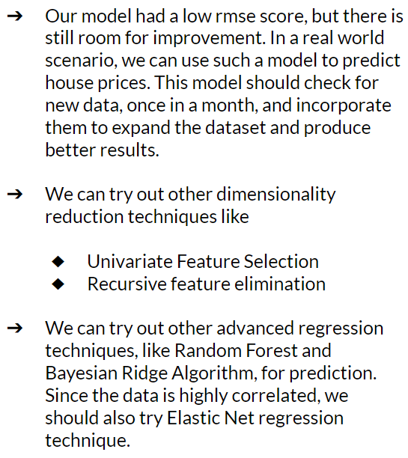
Future Work

Slide 18
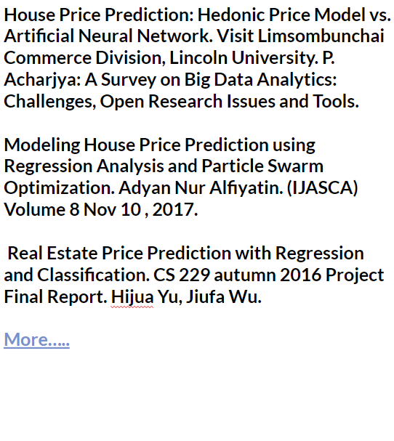
References

Slide 19
THANK YOU

